Slide 1
Machine Learning AIML CZG565
M8 : Bayesian Learning
Course Faculty of M.Tech Cluster
BITS – CSIS - WILP

Slide 2

Machine Learning
Disclaimer and Acknowledgement
These content of modules & context under topics are planned by the course owner Dr. Sugata, with grateful acknowledgement to many others who made their course materials freely available online
We here by acknowledge all the contributors for their material and inputs.
We have provided source information wherever necessary
Students are requested to refer to the textbook w.r.t detailed content of the presentation deck shared over canvas
We have reduced the slides from canvas and modified the content flow to suit the requirements of the course and for ease of class presentation
Slide Source / Preparation / Review:
From BITS Pilani WILP: Prof.Sugata, Prof.Chetana, , Prof.Monali, Prof.Rajavadhana
External: CS109 and CS229 Stanford lecture notes, Dr.Andrew NG and many others who made their course materials freely available online

Slide 3
Course Plan
M1 | Introduction & Mathematical Preliminaries
M2 | Machine Learning Workflow
M3 | Linear Models for Regression
M4 | Linear Models for Classification
M5 | Decision Tree
M6 | Instance Based Learning
M7 | Support Vector Machine – Planned to be discussed after Bayesian Learning
M8 | Bayesian Learning
M9 | Ensemble Learning
M10 | Unsupervised Learning
M11 | Machine Learning Model Evaluation/Comparison

Slide 4
Bayesian Learning Parameter Estimation
Where does the cost come from? - Logistic regression
Why least-squares cost function, be a reasonable choice? – Linear regression

Slide 5
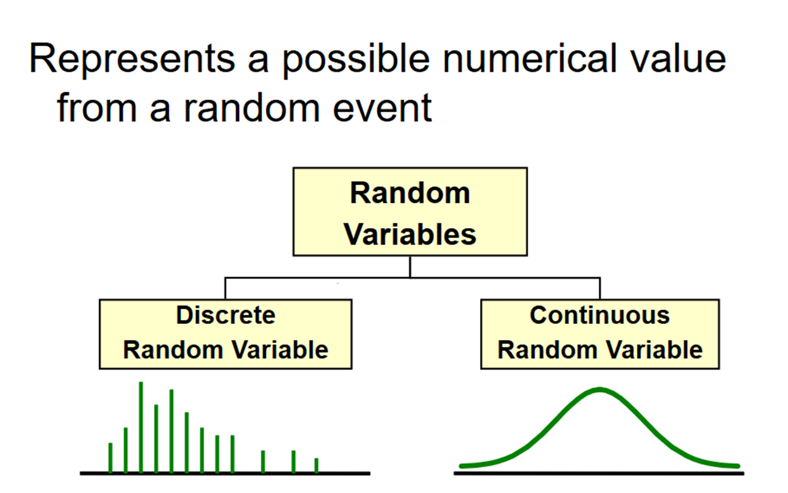
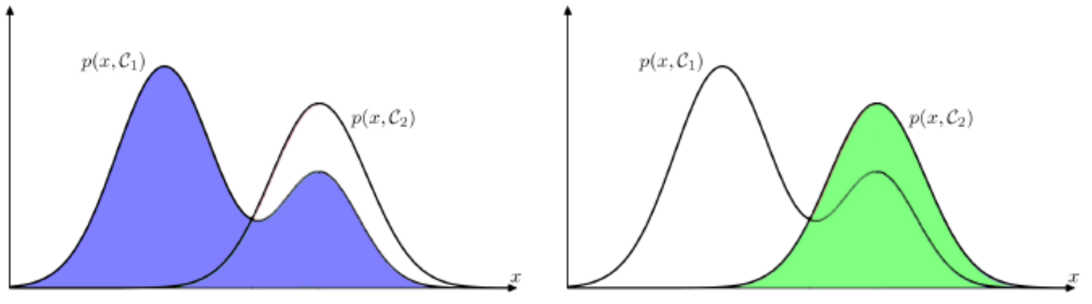
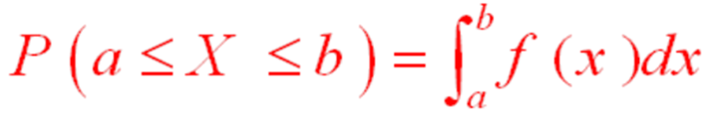
Distribution
Mileage (in kmpl) | Car Price (in cr)
9.8 | 10.48
9.12 | 1.75
9.5 | 6.95
10 | 2.51
Mileage (in kmpl) | Car Price (in cr)
Neutral | High
Less | Low
Neutral | Medium
More | Low
Mileage (in kmpl) | Car Price (in cr)
9.8 | High
9.12 | Low
9.5 | High
10 | Low

Slide 6
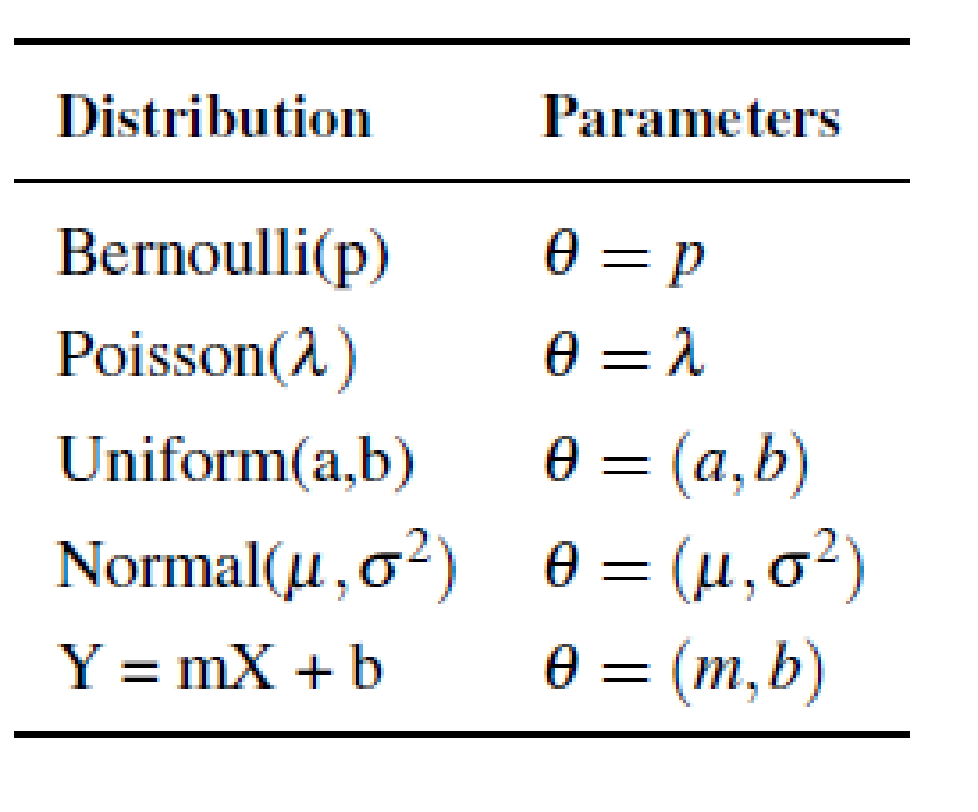
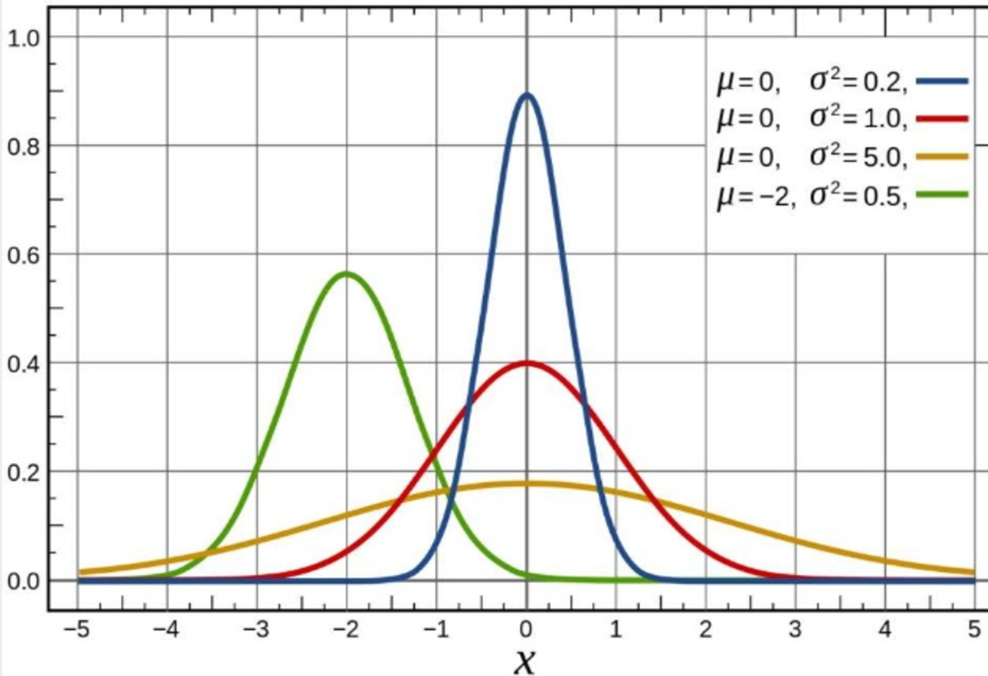
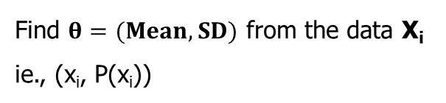
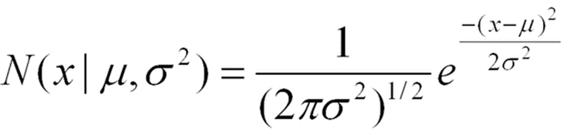
Parameter Estimation
𝜃 is the parameter of a distribution. 𝜃 can be a vector of parameters
Distribution = model + parameter 𝜃

Slide 7
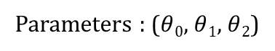
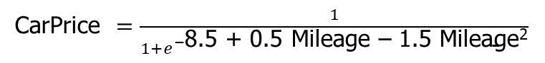
Parameter in ML
Mileage (in kmpl) | Car Price (in cr)
9.8 | 10.48
9.12 | 1.75
9.5 | 6.95
10 | 2.51
CarPrice = 8.5 + 0.5 Mileage – 1.5 Mileage²
Mileage (in kmpl) | Car Price (in cr)
9.8 | High
9.12 | Low
9.5 | High
10 | Low

Slide 8
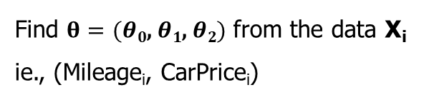
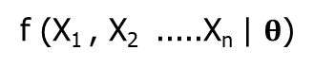
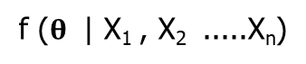
Parameter Estimation in ML
Mileage (in kmpl) | Car Price (in cr)
9.8 | 10.48
9.12 | 1.75
9.5 | 6.95
10 | 2.51
Assumption: Data are__
IID samples: X₁…X_{n}
where all X_{i} are independent and have the same distribution.
Either same PMF (discrete) or same PDF (continuous)
f (X | 𝜃)
Likelihood of different values of X depends on the values of our parameters 𝜃
f( ) is either PDF or PMF
CarPrice = 8.5 + 0.5 Mileage – 1.5 Mileage²
y^{(i)} = θ^{T} x^{(i)} + ε^{(i)}
ε^{(i)} ∼ N(0, σ²)
Maximum Likelihood Estimation (MLE)
select that parameters 𝜃 that make the observed data the most likely
Maximum A Posteriori (MAP)
choose the parameters 𝜃 that is the most likely, given the data

Slide 9
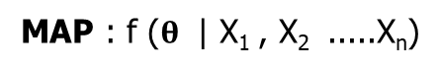
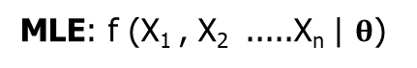
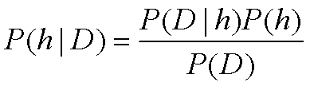
Intuition of Bayes Theorem
P(h) = prior probability of hypothesis h
P(D) = prior probability of training data D
P(h|D) = probability of h given D
P(D|h) = probability of D given h
𝐿 𝜃 , probability of data given parameter 𝜃
After seeing data, posterior belief of 𝜃
likelihood
prior
posterior
𝑃 𝜃 data =
𝑃 data 𝜃 𝑃 𝜃
𝑃 data
Before seeing data,
prior belief of 𝜃
e.g. what is distribution over parameters θ

Slide 10
Maximum Likelihood Estimation (MLE)
Determine formula for 𝐿𝐿(𝜃)
Differentiate 𝐿𝐿(𝜃) w.r.t. (each) 𝜃
Solve

Slide 11
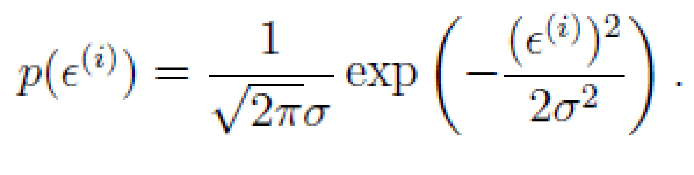
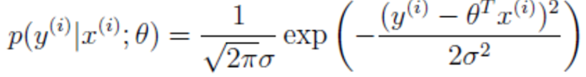
MLE – Linear Regression Model
Given the noise ε^{(i)} obeys a Normal distribution each y^{(i)} must also obey a Normal distribution around the true target value
Mileage (in kmpl) | Car Price (in cr)
9.8 | 10.48
9.12 | 1.75
9.5 | 6.95
10 | 2.51
CarPrice = 8.5 + 0.5 Mileage – 1.5 Mileage²
y^{(i)} = θ^{T} x^{(i)} + ε^{(i)}
ε^{(i)} ∼ N(0, σ²)
y^{(i)} | x^{(i)}; θ ~ N(θ^{T} x^{(i)}, σ²)
Maximum Likelihood Estimation (MLE)
select that parameters 𝜃 that make the observed data the most likely

Slide 12
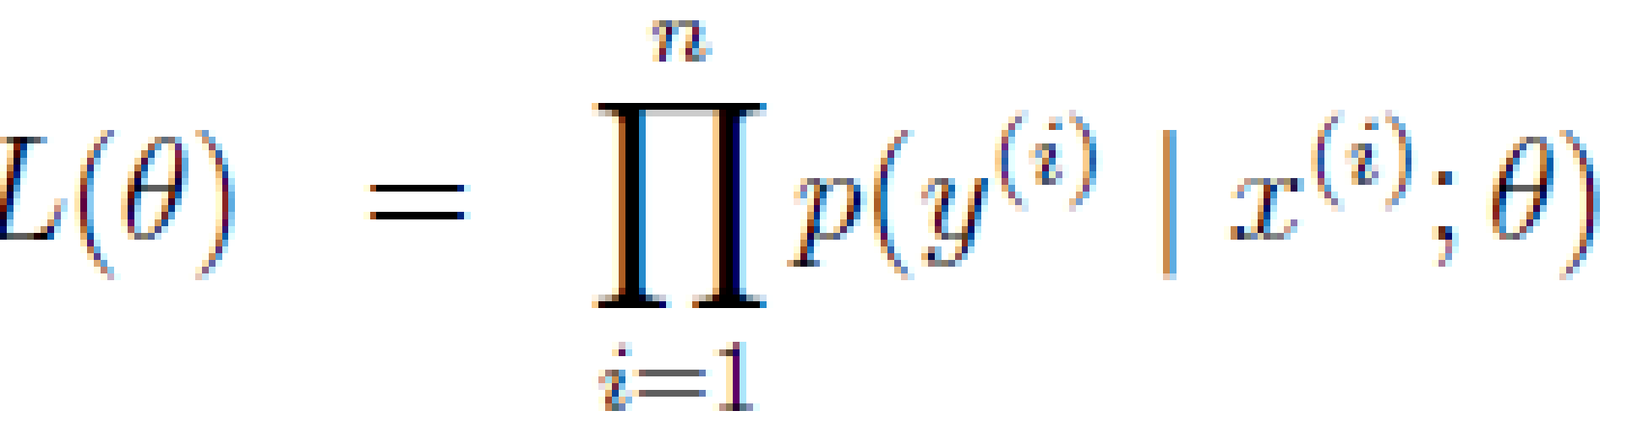
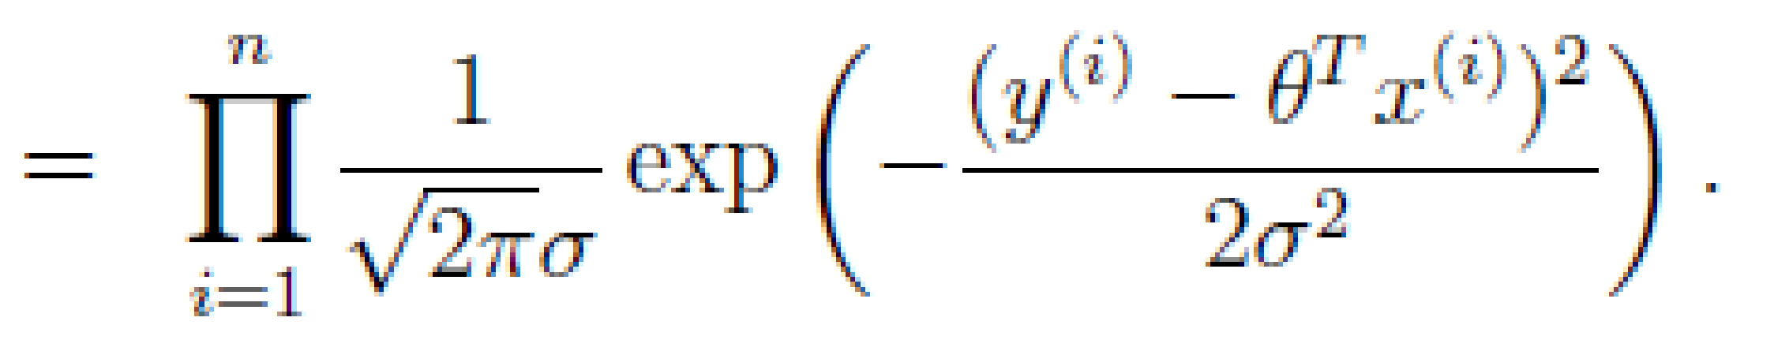
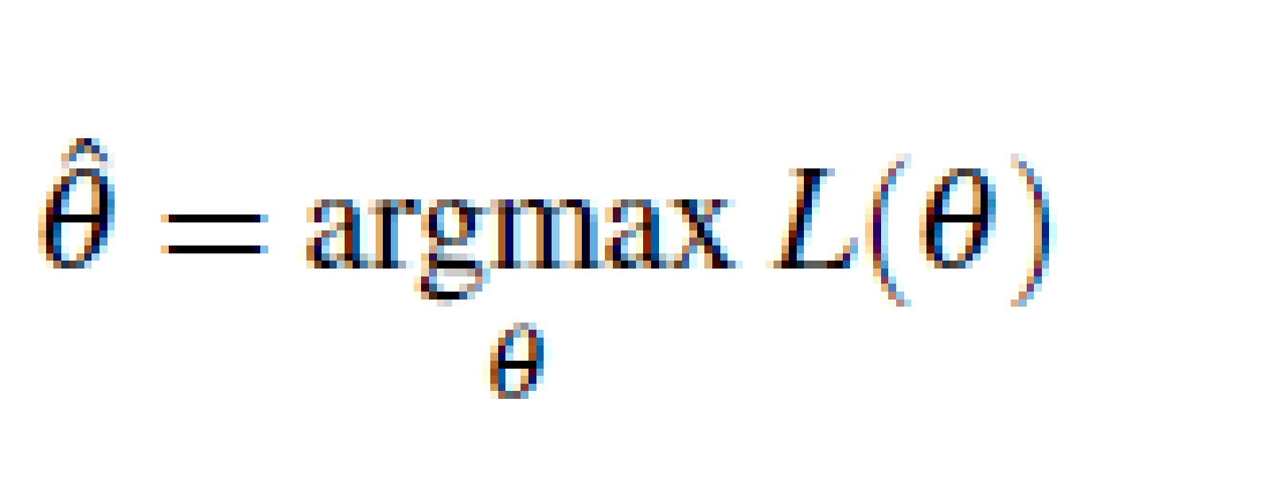
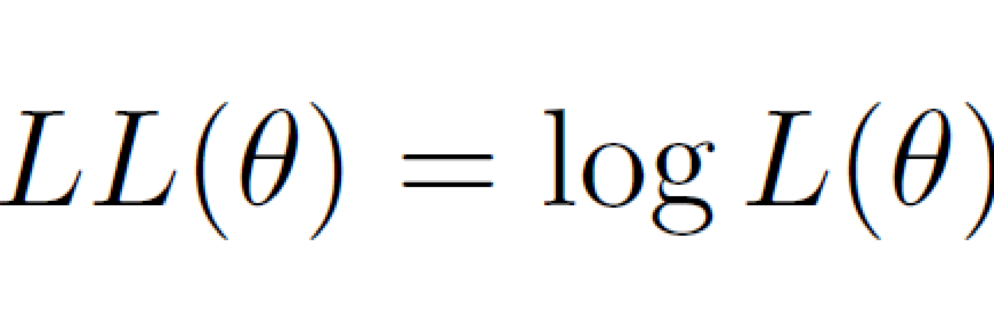
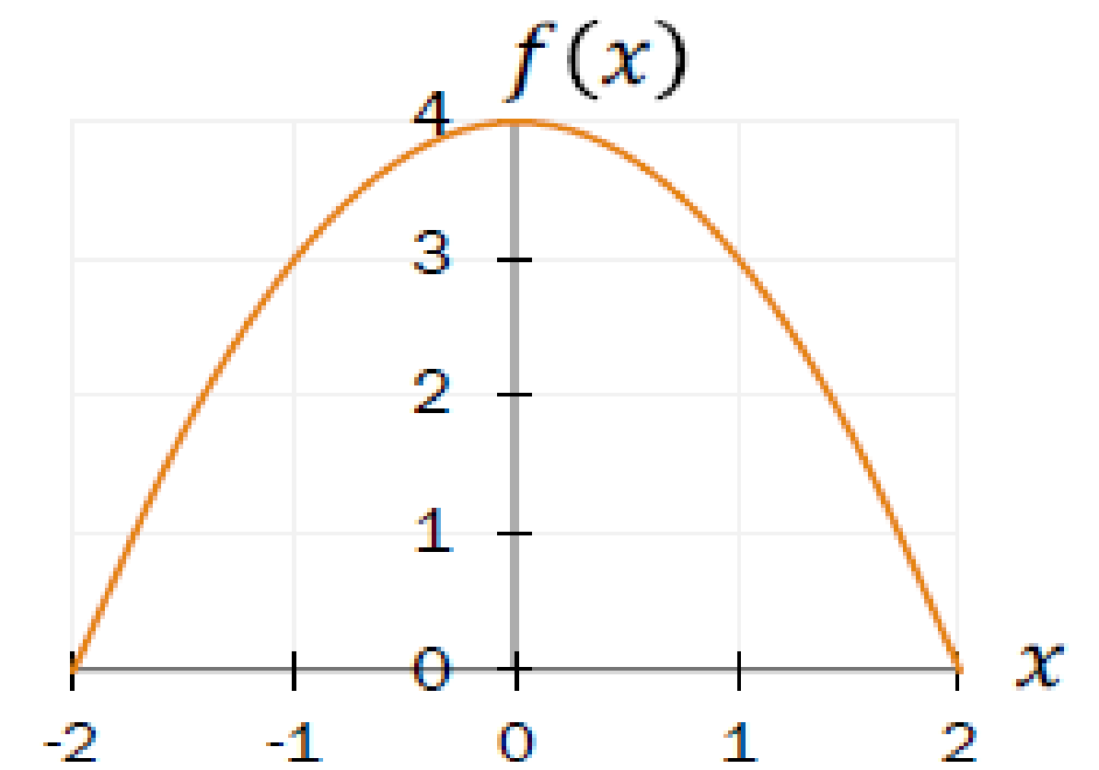
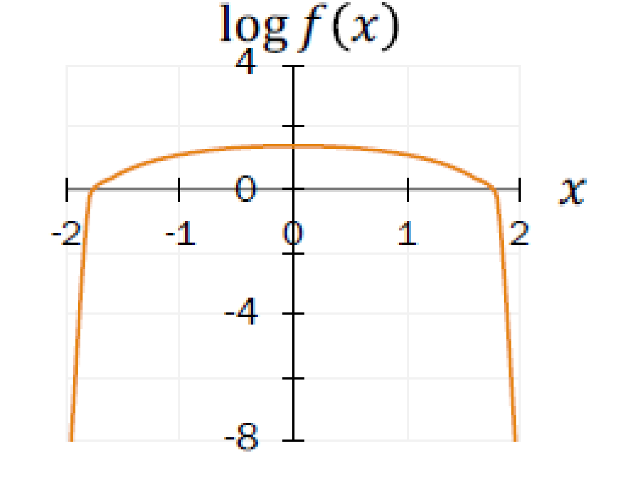
MLE – Linear Regression Model
Determine formula for 𝐿𝐿(𝜃)
Differentiate 𝐿𝐿(𝜃) w.r.t. (each) 𝜃
Solve
Mileage (in kmpl) | Car Price (in cr)
9.8 | 10.48
9.12 | 1.75
9.5 | 6.95
10 | 2.51
MLE answers the question: For which parameter value does the observed data have the largest probability?

Slide 13
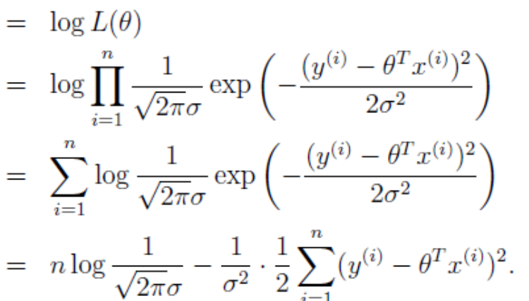
MLE – Linear Regression Model
Determine formula for 𝐿𝐿(𝜃)
Differentiate 𝐿𝐿(𝜃) w.r.t. (each) 𝜃
Solve
Mileage (in kmpl) | Car Price (in cr)
9.8 | 10.48
9.12 | 1.75
9.5 | 6.95
10 | 2.51

Slide 14
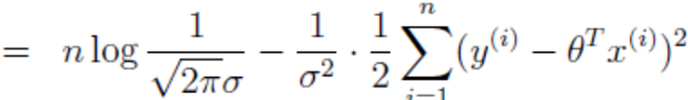
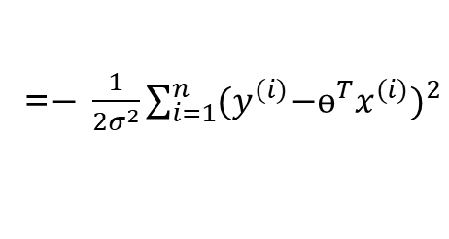
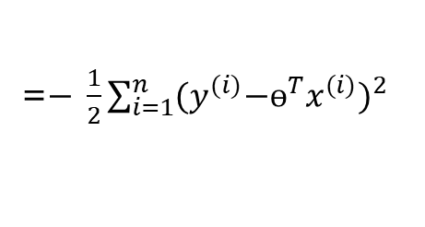
MLE – Linear Regression Model
Determine formula for 𝐿𝐿(𝜃)
Differentiate 𝐿𝐿(𝜃) w.r.t. (each) 𝜃
Solve

Slide 15
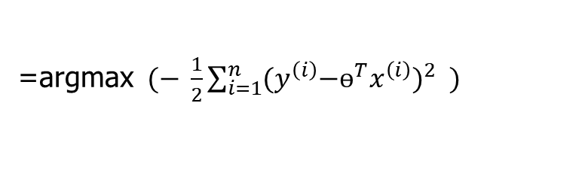
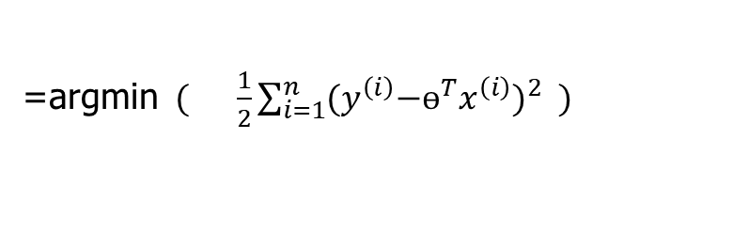
MLE – Linear Regression Model
Determine formula for 𝐿𝐿(𝜃)
Differentiate 𝐿𝐿(𝜃) w.r.t. (each) 𝜃
Solve
With probabilistic assumptions on the data, least-squares regression corresponds to finding the MLE of θ

Slide 16
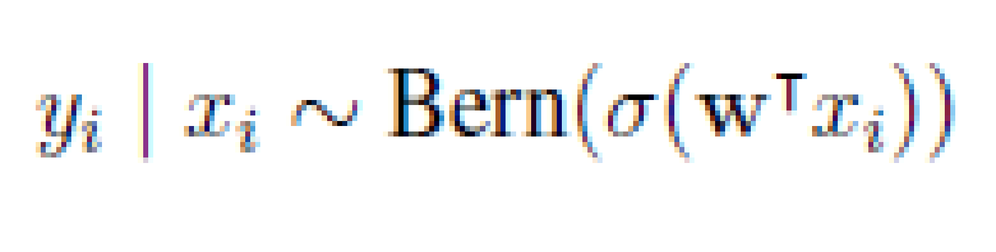

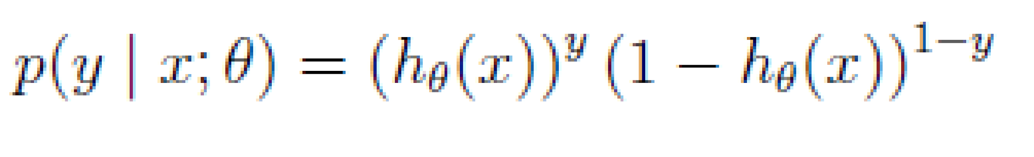
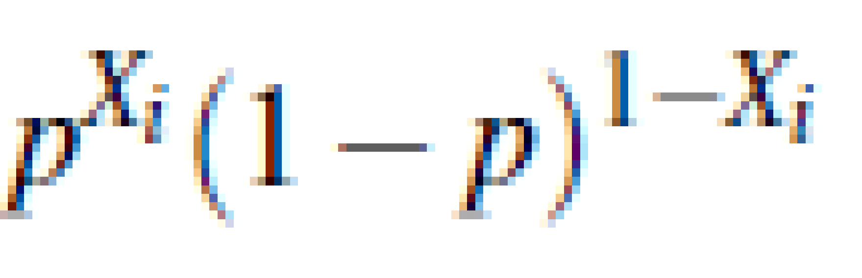
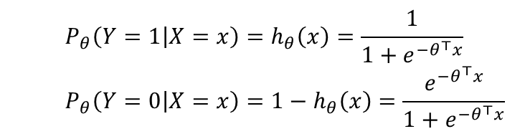
MLE – Logistic Regression
Determine formula for 𝐿𝐿(𝜃)
Differentiate 𝐿𝐿(𝜃) w.r.t. (each) 𝜃
Solve
Mileage (in kmpl) | Car Price (in cr)
9.8 | High
9.12 | Low
9.5 | High
10 | Low
Bernoulli MLE Estimation
X₁,X₂,….,X_{n} where X_{i} ~ Ber(p). PMF of a Bernoulli
MLE answers the question: For which parameter value does the observed data have the largest probability?

Slide 17
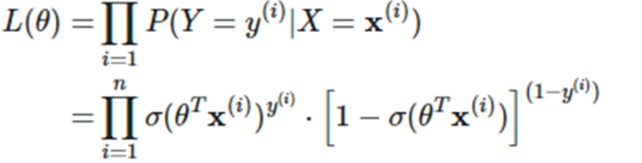
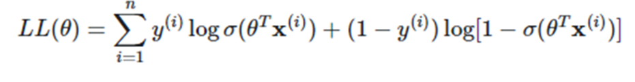
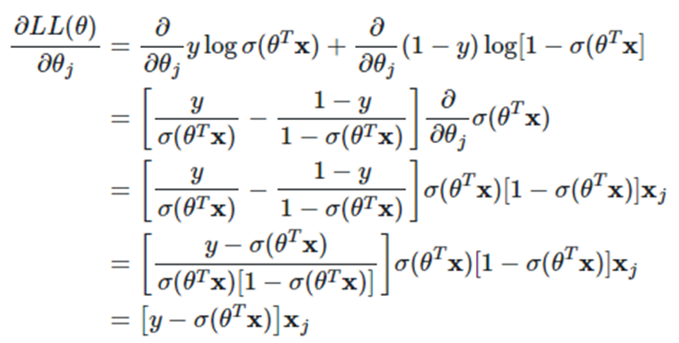
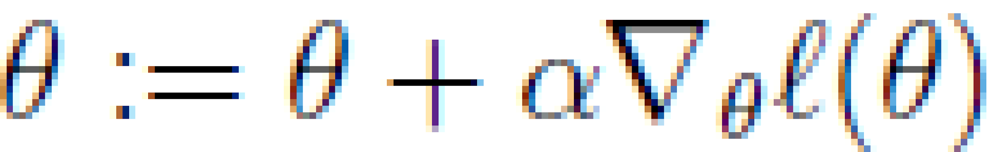
MLE – Logistic Regression
Determine formula for 𝐿𝐿(𝜃)
Differentiate 𝐿𝐿(𝜃) w.r.t. (each) 𝜃
Solve
MLE answers the question: For which parameter value does the observed data have the largest probability?

Slide 18
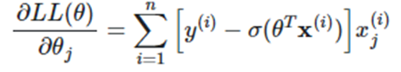
MLE – Logistic Regression
Determine formula for 𝐿𝐿(𝜃)
Differentiate 𝐿𝐿(𝜃) w.r.t. (each) 𝜃
Solve
MLE answers the question: For which parameter value does the observed data have the biggest probability?

Slide 19
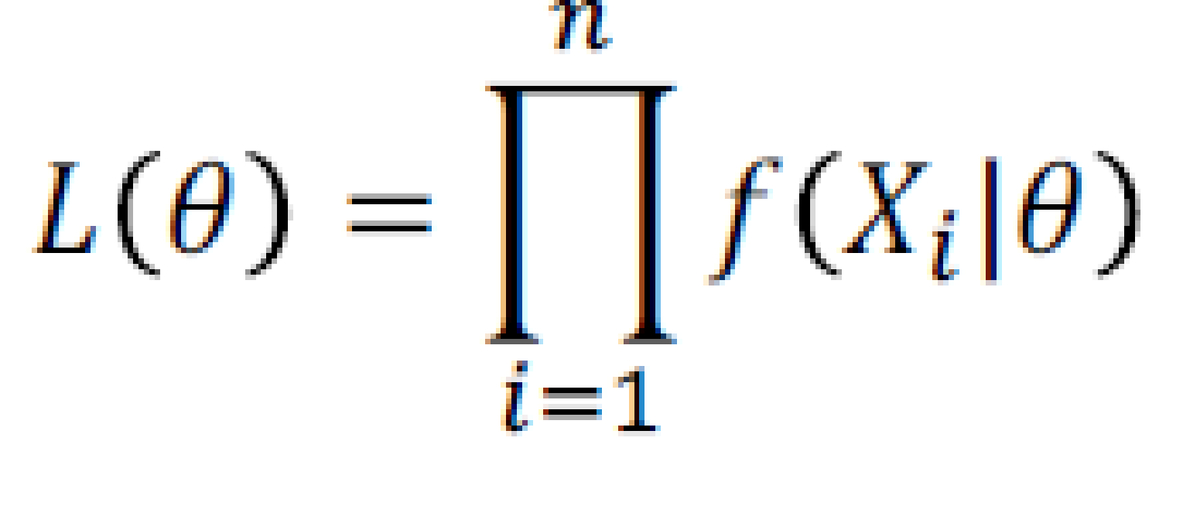
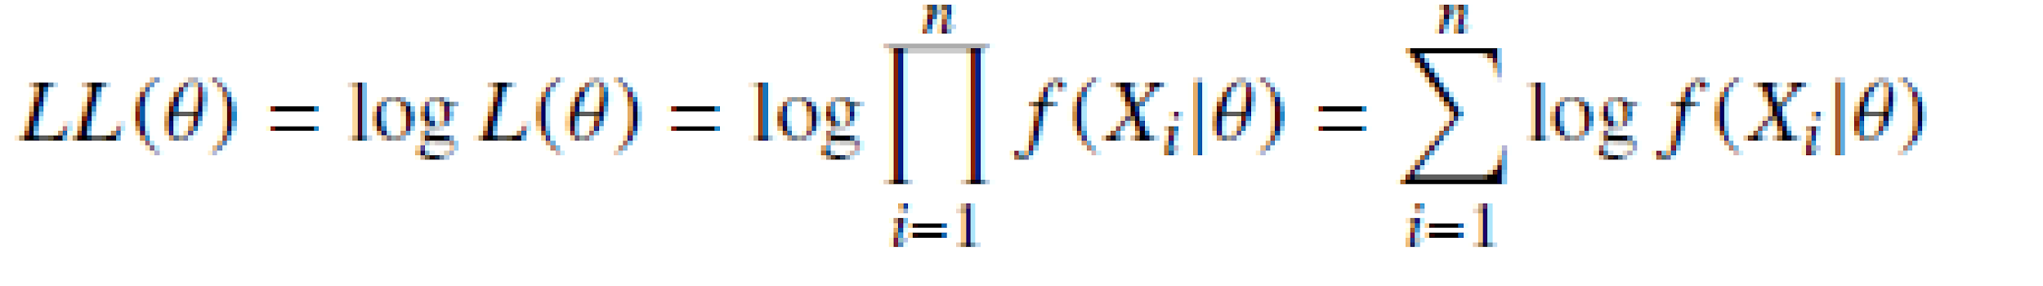
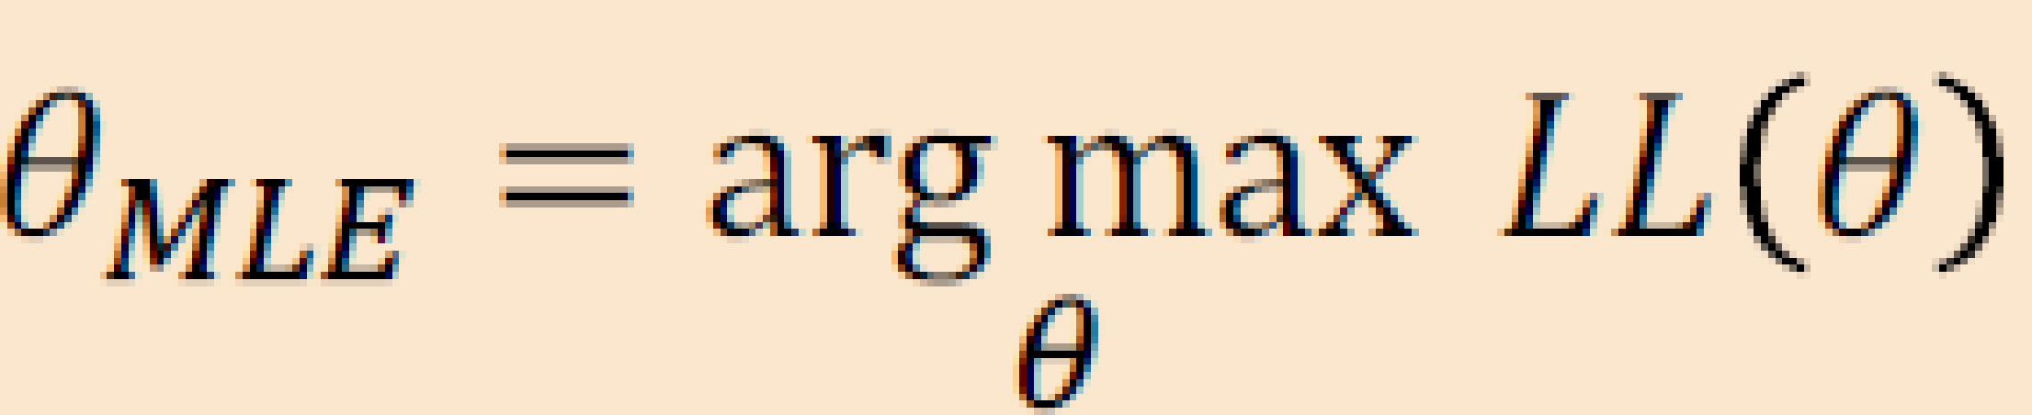
MLE-Summary
Consider a sample of 𝑛 i.i.d. random variables 𝑋₁, 𝑋₂,…, 𝑋_{n}, drawn from a distribution 𝑓(𝑋_{i}|𝜃)
𝜃_{MLE} maximizes the likelihood of data, 𝐿 (𝜃) and 𝐿𝐿 (𝜃)

Slide 20
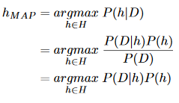
Maximum A Posteriori (MAP) Analysis
Determine prior probability
Find the posterior probability for every distinct prior
Choose the posterior with highest h_{MAP} value
𝜃_{𝑀𝐴𝑃} = arg max 𝑓(𝜃|𝑋₁, 𝑋₂, … , 𝑋_{𝑛})
Brute Force MAP Hypothesis
Maximum a Posteriori (MAP) Estimator of 𝜃 is the value of 𝜃 that maximizes the posterior distribution of 𝜃.
Best hypothesis ≈ most probable hypothesis

Slide 21
Maximum A Posteriori Estimation (MAP)
Find the prior probability
Derive the posterior probability
Differentiate posterior w.r.t. (each) 𝜃
Solve
Maximum a Posteriori (MAP) Estimator of 𝜃 is the value of 𝜃 that maximizes the posterior distribution of 𝜃.
Best hypothesis ≈ most probable hypothesis

Slide 22
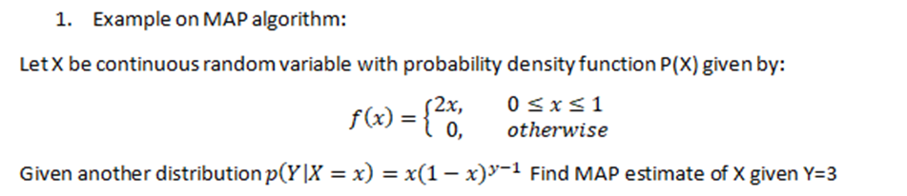
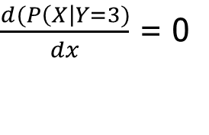
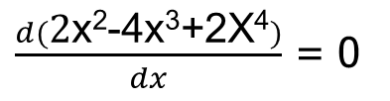
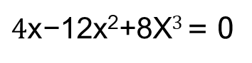
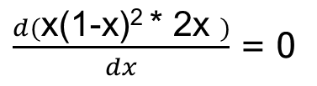
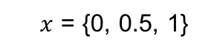
Example :
h _{MAP} = P( X | Y=3)
= P(Y=3 | X) * P(X)
= x(1-x)^{y-1} * 2x
To find the parameter X , differentiate the function & equate to zero.

Slide 23
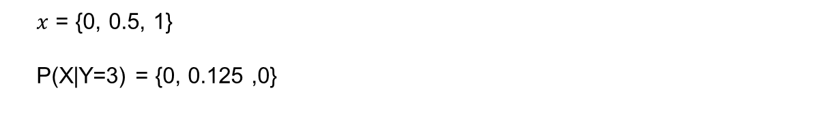
Example :
h _{MAP} = P( X | Y=3)
= P(Y=3 | X) * P(X)
= x(1-x)^{y-1} * 2x

Slide 24
ML setting
Bayesian Analysis
start with some belief about the system, called a prior.
Then we obtain some data and use it to update our belief.
The outcome is called a posterior.
Should we obtain even more data, the old posterior becomes a new prior and the cycle repeats.
P(h | D) a posterior determines the class label
MLE and MAP are the same if the prior is uniform
This forms the basis for Naïve Bayes classifier 🡪 More on this will be discussed in later part of this module

Slide 25

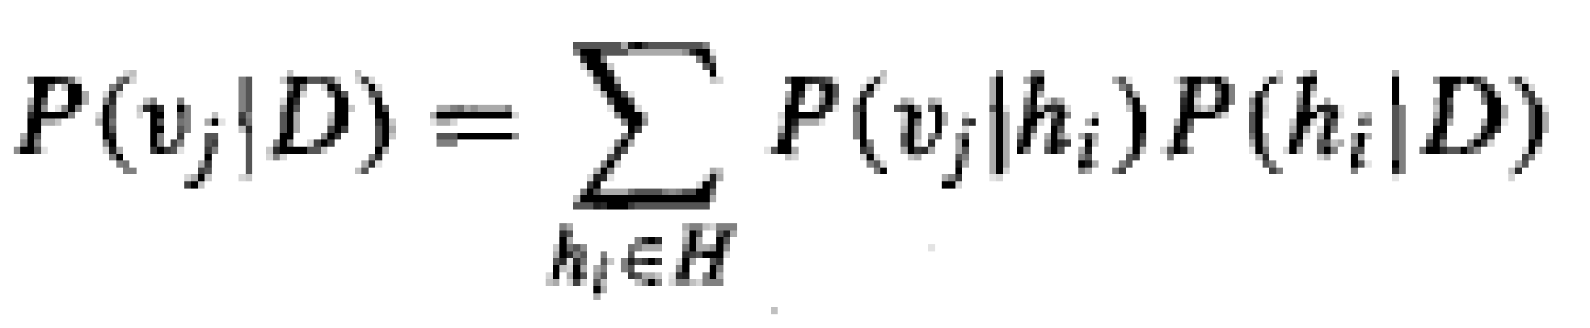
Bayes’ Optimal Classifier
The most probable classification of the new instance is obtained by combining the predictions of all hypotheses, weighted by their posterior probabilities.
v_{j} from some set V, then the probability P(v_{j} l D) that the correct classification for the new instance is v_{j} is:
The optimal classification of the new instance is the value vj for which P(v_{j} l D) is maximum

Slide 26


Most Probable Classification of New Instances
So far we’ve sought the most probable hypothesis given the data D (i.e., h_{MAP})
Given new instance x, what is its most probable classification?
h_{MAP}(x) is not the most probable classification!
What’s most probable classification of x?
Consider:
Three possible hypotheses:
P(h₁|D) = .4, P(h₂|D) = .3, P(h₃|D) = .3
Given new instance x, classification given by above 3 hypotheses is
h₁(x) = +, h₂(x) = −, h₃(x) = −
May be the classification for X is +
and

Slide 27



Example 1 : Bayes Optimal Classifier
Bayes optimal classification:
Example:
P(h₁|D) = .4, P(−|h₁) = 0, P(+|h₁) = 1
P(h₂|D) = .3, P(−|h₂) = 1, P(+|h₂) = 0
P(h₃|D) = .3, P(−|h₃) = 1, P(+|h₃) = 0
therefore
and

Slide 28
Gibbs Classifier
Bayes optimal classifier provides best result, but can be expensive if many hypotheses.
Gibbs algorithm:
Choose one hypothesis at random, according to posterior prob. Distribution over h , P(h|D)
Use this h to classify new instance
Surprising fact: under certain conditions, the expected misclassification error for the Gibbs algorithm is at most twice the expected error of the Bayes optimal classifier
E[error_{Gibbs}] ≤ 2E [error_{BayesOptional}]
Suppose correct, uniform prior distribution over H, then
Pick any hypothesis from Version space, with uniform probability
Its expected error no worse than twice Bayes optimal

Slide 29
Parameter Estimation in ML - Summary
Assumption: Data are__
IID samples: X₁…X_{n}
where all X_{i} are independent and have the same distribution.
Either same PMF (discrete) or same PDF (continuous)
f (X | 𝜃)
Likelihood of different values of X depends on the values of our parameters 𝜃
f( ) is either PDF or PMF
Maximum Likelihood Estimation (MLE)
select that parameters 𝜃 that make the observed data the most likely
Maximum A Posteriori (MAP)
choose the parameters 𝜃 that is the most likely, given the data
If the sample is large, MLE will yield an excellent estimator of θ
When no prior information is available, all hypothesis are equally likely i.e. p(hi) = p(hj)

Slide 30
Additional Problems in MLE

Slide 31

MLE – Discrete - PMF
Determine formula for 𝐿𝐿(𝜃)
Differentiate 𝐿𝐿(𝜃) w.r.t. (each) 𝜃
Solve

Slide 32
MLE – Discrete - PMF
Determine formula for 𝐿𝐿(𝜃)
Differentiate 𝐿𝐿(𝜃) w.r.t. (each) 𝜃
Solve
L(ɵ) = P(X=3)*P(X=0)*P(X=2)*……..*P(X=1)
= ((1-ɵ) / 3)² * (2ɵ / 3)² * (2(1-ɵ) / 3)³ * (ɵ/ 3)³
X | P(X)
3 | (1-ɵ) / 3
0 | 2ɵ / 3
2 | 2(1-ɵ) / 3
1 | ɵ/ 3
3 | (1-ɵ) / 3
2 | 2(1-ɵ) / 3
1 | ɵ/ 3
0 | 2ɵ / 3
2 | 2(1-ɵ) / 3
1 | ɵ/ 3

Slide 33


MLE – Discrete - PMF
Determine formula for 𝐿𝐿(𝜃)
2. Differentiate 𝐿𝐿(𝜃) w.r.t. (each) 𝜃
3. Solve

Slide 34




Additional Exercise for Student’s Practice
Consider inputs x_{i} which are real valued attributes and the outputs y_{i} which are real
valued of the form , where f(x_{i}) is the true function and e_{i} is a random variable representing laplacian noise with PDF given by
Implementing a linear regression model of the form , and ,
find the maximum likelihood estimator of è. Comment on the loss function.

Slide 35

Additional Exercise for Student’s Practice
Determine formula for 𝐿𝐿(𝜃)
Differentiate 𝐿𝐿(𝜃) w.r.t. (each) 𝜃
Solve

Slide 36
Naïve Bayes Classifier

Slide 37


Decision Theory: Generative Models
Generative
x₂
x₁
Sky | AirTemp | Humidity | Wind | Forecast | Enjoy Sport?
Sunny | Warm | Normal | Strong | Same | Yes
Sunny | Warm | High | Strong | Same | No
Rainy | Cold | High | Strong | Change | No
Sunny | Warm | Normal | Breeze | Same | Yes
Sunny | Hot | Normal | Breeze | Same | No
Rainy | Cold | High | Strong | Change | No
Sunny | Warm | High | Strong | Change | Yes
Rainy | Warm | Normal | Breeze | Same | Yes
Known as generative models, because by sampling from them it is possible to generate synthetic data points in the input space.
Eg., Gaussians, Naïve Bayes, Mixtures of multinomials , Mixtures of Gaussians, Bayesian networks

Slide 38


Generative models for classification
For binary classification the denominator is given by
p(x) = p(x|y = 1)p(y = 1) + p(x|y = 0)p(y = 0)
if were calculating p(y|x) in order to make a prediction, then we don’t actually need to calculate the denominator, since

Slide 39

Naïve Bayes Classifier - Applications

Slide 40

Example: Digit Recognition
X₁,…,X_{n} ∈ {0,1} (Black vs. White pixels)
Y ∈ {5,6} (predict whether a digit is a 5 or a 6)
Classifier

Slide 41

The Bayes Classifier
To classify, we’ll simply compute these two probabilities and predict based on which one is greater

Slide 42

Naïve Bayes conditional Independence assumption

Slide 43

Naïve Bayes classifier: Prediction
Goal of learning P(Y|X) where X = <X₁,…, X_{n}>

Slide 44

Example: Play Tennis
Sky | AirTemp | Humidity | Wind | Forecast | Enjoy Sport?
Sunny | Warm | Normal | Strong | Same | Yes
Sunny | Warm | High | Strong | Same | No
Rainy | Cold | High | Strong | Change | No
Sunny | Warm | Normal | Breeze | Same | Yes
Sunny | Hot | Normal | Breeze | Same | No
Rainy | Cold | High | Strong | Change | No
Sunny | Warm | High | Strong | Change | Yes
Rainy | Warm | Normal | Breeze | Same | Yes

Slide 45

Example: Play Tennis – Learning Phase
Look up tables
Maximum likelihood estimates (MLE’s):
Sky | Play=Yes | Play=No
Sunny | 3/3 | 2/4
Rainy | 0/3 | 2/4
Number of items in dataset D for which Y=y_{k}
Wind | Play=Yes | Play=No
Strong | 2/3 | 3/4
Breeze | 1/3 | 1/4
Sky | AirTemp | Humidity | Wind | Forecast | Enjoy Sport?
Sunny | Warm | Normal | Strong | Same | Yes
Sunny | Warm | High | Strong | Same | No
Rainy | Cold | High | Strong | Change | No
Sunny | Warm | Normal | Breeze | Same | Yes
Sunny | Hot | Normal | Breeze | Same | No
Rainy | Cold | High | Strong | Change | No
Sunny | Warm | High | Strong | Change | Yes
Rainy | Warm | Normal | Breeze | Same | Yes
AirTemp | Play=Yes | Play=No
Hot | 0/3 | 1/4
Warm | 3/3 | 1/4
Cold | 0/3 | 2/4
Forecast | Play=Yes | Play=No
Same | 2/3 | 2/4
Change | 1/3 | 2/4
Humidity | Play=Yes | Play=No
High | 1/3 | 3/4
Normal | 2/3 | 1/4

Slide 46

Example: Play Tennis - Testing Phase
MAP rule
P(Enjoy=Yes | X) = P(X | Enjoy=Yes). P(Enjoy=Yes) / P(X)
= P(X | Enjoy=Yes). P(Enjoy=Yes)
= P(X | Enjoy=Yes). (3/7)
= P(Sunny | Enjoy=Yes). P(Warm | Enjoy=Yes). P(Normal | Enjoy=Yes). P(Strong | Enjoy=Yes). P(Change | Enjoy=Yes).(3/7)
= (3/3) . (3/3) . (2/3) . (2/3) . (1/3) . (3/7)
=0.0635
P(Enjoy=Yes | X) > P(Enjoy=No | X) 🡪 EnjoySport = Yes
P(Enjoy=No | X) = P(X | Enjoy=No). P(Enjoy=No) / P(X)
= P(X | Enjoy=No). P(Enjoy=No)
= P(X | Enjoy=No). (4/7)
= P(Sunny | Enjoy=No). P(Warm | Enjoy=No). P(Normal | Enjoy=No). P(Strong | Enjoy=No). P(Change | Enjoy=No). (4/7)
= (2/4) . (1/4) . (1/4) . (3/4) . (2/4) . (4/7)
= 0.006696
Sky | AirTemp | Humidity | Wind | Forecast | Enjoy Sport?
Sunny | Warm | Normal | Strong | Same | Yes
Sunny | Warm | High | Strong | Same | No
Rainy | Cold | High | Strong | Change | No
Sunny | Warm | Normal | Breeze | Same | Yes
Sunny | Hot | Normal | Breeze | Same | No
Rainy | Cold | High | Strong | Change | No
Sunny | Warm | High | Strong | Change | Yes
Sunny | Warm | Normal | Strong | Change | ????
Rainy | Warm | Normal | Breeze | Same | ????

Slide 47

Naïve Bayes Algorithm – discrete X_{i}
Train Naïve Bayes (examples) for each* value y_{k}
estimate
for each* value x_{ij} of each attribute X_{i}
estimate
Classify (X^{new})

Slide 48
Example: Play Tennis
P(Enjoy=Yes | X) = P(X | Enjoy=Yes). P(Enjoy=Yes) / P(X)
= P(X | Enjoy=Yes). P(Enjoy=Yes)
= P(X | Enjoy=Yes). (3/7)
= P(Rainy | Enjoy=Yes). P(Warm | Enjoy=Yes). P(Normal | Enjoy=Yes). P(Breeze | Enjoy=Yes). P(Same | Enjoy=Yes).(3/7)
= (0+1/3) . (3/3) . (2/3) . (1/3) . (2/3) . (3/7)
P(Enjoy=No | X) = P(X | Enjoy=No). P(Enjoy=No) / P(X)
= P(X | Enjoy=No). P(Enjoy=No)
= P(X | Enjoy=No). (4/7)
= P(Rainy | Enjoy=No). P(Warm | Enjoy=No). P(Normal | Enjoy=No). P(Breeze | Enjoy=No). P(Same | Enjoy=No). (4/7)
= (2+1/4) . (1/4) . (1/4) . (1/4) . (2/4) . (4/7)
Sky | Enjoy Sport?
Sunny | Yes
Sunny | No
Rainy | No
Sunny | Yes
Sunny | No
Rainy | No
Sunny | Yes
Rainy | ????
AirTemp | Humidity | Wind | Forecast | Enjoy Sport?
Warm | Normal | Strong | Same | Yes
Warm | High | Strong | Same | No
Cold | High | Strong | Change | No
Warm | Normal | Breeze | Same | Yes
Hot | Normal | Breeze | Same | No
Cold | High | Strong | Change | No
Warm | High | Strong | Change | Yes
Warm | Normal | Breeze | Same | ????

Slide 49
Laplace Smoothing

Slide 50

Smoothing
Technique for smoothing categorical data.
A small-sample correction, or pseudo-count, will be incorporated in every probability estimate.
No probability will be zero.

Slide 51

Smoothing
Probability estimation:
d: number of distinct values of an attribute
N_{c}: number of instances in the class
N_{ic}: number of instances having attribute value A_{i} in class c
p: prior probability of the class
m: constant called the equivalent sample size, which determines how heavily to weight p relative to the observed data
Bayesian approach

Slide 52

Example: Play Tennis
P(Enjoy=Yes | X) = P(X | Enjoy=Yes). P(Enjoy=Yes) / P(X)
= P(X | Enjoy=Yes). P(Enjoy=Yes)
= P(X | Enjoy=Yes). (3/7)
= P(Rainy | Enjoy=Yes). P(Warm | Enjoy=Yes). P(Normal | Enjoy=Yes). P(Breeze | Enjoy=Yes). P(Same | Enjoy=Yes).(3/7)
= (0+1/3+2) . (3 +1/3+3) . (2+1/3+2) . (1+1/3+2) . (2+1/3+2) . (3+1/7+2)
P(Enjoy=No | X) = P(X | Enjoy=No). P(Enjoy=No) / P(X)
= P(X | Enjoy=No). P(Enjoy=No)
= P(X | Enjoy=No). (4/7)
= P(Rainy | Enjoy=No). P(Warm | Enjoy=No). P(Normal | Enjoy=No). P(Breeze | Enjoy=No). P(Same | Enjoy=No). (4/7)
= (2+1/4+2) . (1+1/4+3) . (1+1/4+2) . (1+1/4+2) . (2+1/4+2) . (4+1/7+2)
Sky | AirTemp | Humidity | Wind | Forecast | Enjoy Sport?
Sunny | Warm | Normal | Strong | Same | Yes
Sunny | Warm | High | Strong | Same | No
Rainy | Cold | High | Strong | Change | No
Sunny | Warm | Normal | Breeze | Same | Yes
Sunny | Hot | Normal | Breeze | Same | No
Rainy | Cold | High | Strong | Change | No
Sunny | Warm | High | Strong | Change | Yes
Rainy | Warm | Normal | Breeze | Same | Yes

Slide 53
Example: Play Tennis
P(Enjoy=Yes | X) = P(X | Enjoy=Yes). P(Enjoy=Yes) / P(X)
= P(X | Enjoy=Yes). P(Enjoy=Yes)
= P(X | Enjoy=Yes). (3/7)
= P(Rainy | Enjoy=Yes). P(Warm | Enjoy=Yes). P(Normal | Enjoy=Yes). P(Breeze | Enjoy=Yes). P(Same | Enjoy=Yes).(3/7)
P(Enjoy=Yes | X) > P(Enjoy=No | X) 🡪 EnjoySport = Yes
P(Enjoy=No | X) = P(X | Enjoy=No). P(Enjoy=No) / P(X)
= P(X | Enjoy=No). P(Enjoy=No)
= P(X | Enjoy=No). (4/7)
= P(Rainy | Enjoy=No). P(Warm | Enjoy=No). P(Normal | Enjoy=No). P(Breeze | Enjoy=No). P(Same | Enjoy=No). (4/7)
Sky | AirTemp | Humidity | Wind | Forecast | Enjoy Sport?
Sunny | Warm | Normal | Strong | Same | Yes
Sunny | Warm | High | Strong | Same | No
Rainy | Cold | High | Strong | Change | No
Sunny | Warm | Normal | Breeze | Same | Yes
Sunny | Hot | Normal | Breeze | Same | No
Rainy | Cold | High | Strong | Change | No
Sunny | Warm | High | Strong | Change | Yes
Sunny | Warm | Normal | Strong | Change | ????
Rainy | Warm | Normal | Breeze | Same | ????

Slide 54

Continuous Features
Continuous variable follows a probability distribution — typically a Gaussian (Normal) distribution
x

Slide 55

Humidity | Enjoy Sport?
85 | Yes
80 | No
70 | No
83 | Yes
90 | No
50 | No
85 | Yes
60 | ????
AirTemp | Sky | Wind | Forecast | Enjoy Sport?
Warm | Sunny | Strong | Same | Yes
Warm | Sunny | Strong | Same | No
Cold | Rainy | Strong | Change | No
Warm | Rainy | Breeze | Same | Yes
Hot | Sunny | Breeze | Same | No
Cold | Rainy | Strong | Change | No
Warm | Sunny | Strong | Change | Yes
Warm | Rainy | Breeze | Same | ????

Slide 56

Humidity | Enjoy Sport?
85 | Yes
80 | No
70 | No
83 | Yes
90 | No
50 | No
85 | Yes
60 | ????
AirTemp | Sky | Wind | Forecast | Enjoy Sport?
Warm | Sunny | Strong | Same | Yes
Warm | Sunny | Strong | Same | No
Cold | Rainy | Strong | Change | No
Warm | Rainy | Breeze | Same | Yes
Hot | Sunny | Breeze | Same | No
Cold | Rainy | Strong | Change | No
Warm | Sunny | Strong | Change | Yes
Warm | Rainy | Breeze | Same | ????

Slide 57
Example: Play Tennis
P(Enjoy=Yes | X) = P(X | Enjoy=Yes). P(Enjoy=Yes) / P(X)
= P(X | Enjoy=Yes). P(Enjoy=Yes)
= P(X | Enjoy=Yes). (3/7)
= P(Rainy | Enjoy=Yes). P(Warm | Enjoy=Yes). P(60 | Enjoy=Yes). P(Breeze | Enjoy=Yes). P(Same | Enjoy=Yes).(3/7)
= (1/3) . (3/3) . 0.15*10⁻⁹⁵ . (1/3) . (2/3) . (3/7)
P(Enjoy=No | X) = P(X | Enjoy=No). P(Enjoy=No) / P(X)
= P(X | Enjoy=No). P(Enjoy=No)
= P(X | Enjoy=No). (4/7)
= P(Rainy | Enjoy=No). P(Warm | Enjoy=No). P(60 | Enjoy=No). P(Breeze | Enjoy=No). P(Same | Enjoy=No). (4/7)
= (2/4) . (1/4) . 0.02 . (1/4) . (2/4) . (4/7)
Humidity | Enjoy Sport?
85 | Yes
80 | No
70 | No
83 | Yes
90 | No
50 | No
85 | Yes
60 | ????
AirTemp | Sky | Wind | Forecast | Enjoy Sport?
Warm | Sunny | Strong | Same | Yes
Warm | Sunny | Strong | Same | No
Cold | Rainy | Strong | Change | No
Warm | Rainy | Breeze | Same | Yes
Hot | Sunny | Breeze | Same | No
Cold | Rainy | Strong | Change | No
Warm | Sunny | Strong | Change | Yes
Warm | Rainy | Breeze | Same | ????

Slide 58
Additional Exercises – For Student’s Practice
As a part of efforts to improve students’ performance in the exams, you have been given the data showing number of study hours spent by students, their gender and their final results as pass or fail. Using this sample dataset, apply Naïve Bayes classification technique, to classify the below test case:
{No of study hours = 3.5, Gender=”male”} either as “Pass”, or “Fail”.
No of study hours | Gender | Final result
4.5 | Male | Pass
7 | Female | Pass
2 | Male | Fail
4 | Female | Fail
2.5 | Male | Fail
3 | Female | Fail
8.3 | Male | Fail
8 | Female | Pass
9 | Male | Pass

Slide 59

Additional Exercises – For Student’s Practice
P(Pass | X) = P(X | Pass). P(Pass) / P(X)
= P(X | Pass). P(Pass)
= P(X | Pass). (0.44)
= P(Male | Pass). P(3.5 | Pass).(0.44)
= (2/4). 0.1056 . (0.44) = 0.0235
P(Fail | X) = P(X | Fail). P(Fail) / P(X)
= P(X | Fail). P(Fail)
= P(X | Fail). (0.56)
= P(Male | Fail). P(3.5 | Fail).(0.56)
= (3/5). 0.1846 . (0.56) = 0.0615
No of study hours | Gender | Final result
4.5 | Male | Pass
7 | Female | Pass
2 | Male | Fail
4 | Female | Fail
2.5 | Male | Fail
3 | Female | Fail
8.3 | Male | Fail
8 | Female | Pass
9 | Male | Pass

Slide 60
Text Classification using Naive Bayes Classifier

Slide 61
The Bag of Words Representation
it | 6
I | 5
the | 4
to | 3
and | 3
seen | 2
yet | 1
would | 1
whimsical | 1
times | 1
sweet | 1
satirical | 1
adventure | 1
genre | 1
fairy | 1
humor | 1
have | 1
great | 1
… | …
I love this movie! It's sweet, but with satirical humor. The dialogue is great and the adventure scenes are fun... It manages to be whimsical and romantic while laughing at the conventions of the fairy tale genre. I would recommend it to just about anyone. I've seen it several times, and I'm always happy to see it again whenever I have a friend who hasn't seen it yet!
fairy
it and
always love_{to} ^{it} whimsical it
I
seen
are
anyone
friend
happy
dialogue
adventure
recommend
satirical
_{who}sweet of _{movie}
it I
it ^{I} but ^{to} romantic
several
yet it
again
the
humor
the
seen
would
to scenes I
the manages
fun ^{the} times _{and}
I
and
about
whenever
have
while
conventions with

Slide 62


Example : Multinomial model :
Which Tag sentence “ A very close game” belong to?
P(Sports=Yes) = 3/5
P(Sports=No) = 2/5
P(A | Sports=Yes) = 2/11
P(A | Sports=No) = 1/9
P(Sports=Yes | X) = P(X | Sports=Yes). P(Sports=Yes) / P(X)
= P(X | Sports=Yes). (3/5)
= P(A| Sports=Yes). P(Very | Sports=Yes). P(Close | Sports=Yes). P(Game | Sports=Yes). (3/5)
= (2/11) . (1/11) . (0/11) . (2/11) . (3/5)
A | Great | Game | The | Election | Was | Over | Very | Clean | Match | But | Forgettable | It | Close | Sports or Not Sports
1 | 1 | 1 |  |  |  |  |  |  |  |  |  |  |  | 1
 |  |  | 1 | 1 | 1 | 1 |  |  |  |  |  |  |  | 0
 |  |  |  |  |  |  | 1 | 1 | 1 |  |  |  |  | 1
1 |  | 1 |  |  |  |  |  | 1 |  | 1 | 1 |  |  | 1
1 |  |  |  | 1 | 1 |  |  |  |  |  |  | 1 | 1 | 0
1 |  | 1 |  |  |  |  | 1 |  |  |  |  |  | 1 | ????

Slide 63

Laplace Smoothing
In our example
we add 1 to every probability, therefore the probability, such as P(close | sports), will never be 0.

Slide 64
Example : Multinomial model :
Which Tag sentence “ A very close game” belong to?
P(Sports=Yes) = 3/5
P(Sports=No) = 2/5
P(A | Sports=Yes) = 2/11
P(A | Sports=No) = 1/9
P(Sports=Yes | X) = P(X | Sports=Yes). P(Sports=Yes) / P(X)
= P(X | Sports=Yes). (3/5)
= P(A| Sports=Yes). P(Very | Sports=Yes). P(Close | Sports=Yes). P(Game | Sports=Yes). (3/5)
= (2/11) . (1/11) . (0/11) . (2/11) . (3/5)
= (2+1/11+14) . (1+1/11+14) . (0+1/11+14) . (2+1/11+14) . (3/5) (3+14/5+28)
= 0.00002765 =0.00002396
A | Great | Game | The | Election | Was | Over | Very | Clean | Match | But | Forgettable | It | Close | Sports or Not Sports
1 | 1 | 1 |  |  |  |  |  |  |  |  |  |  |  | 1
 |  |  | 1 | 1 | 1 | 1 |  |  |  |  |  |  |  | 0
 |  |  |  |  |  |  | 1 | 1 | 1 |  |  |  |  | 1
1 |  | 1 |  |  |  |  |  | 1 |  | 1 | 1 |  |  | 1
1 |  |  |  | 1 | 1 |  |  |  |  |  |  | 1 | 1 | 0
1 |  | 1 |  |  |  |  | 1 |  |  |  |  |  | 1 | ????

Slide 65


Slide 66



Example 2: Multinomial model
N_{yes} (W=Chinese) = 5, N_{No} (W=Chinese) = 1,
|v| = 6 = {Chinese, Beijing, Shanghai, Macao, Tokyo Japan}
No of features (words) in Yes class = 8
No of features (words) in No class = 3
Source Credit : https://nlp.stanford.edu/IR-book
66

Slide 67


Example 2
Source Credit : https://nlp.stanford.edu/IR-book
67

Slide 68


Example 2
u-each word in test document
Source Credit : https://nlp.stanford.edu/IR-book

Slide 69

Different Naive Bayes model: Bernoulli model
One feature X_{w} for each word in dictionary
X_{w} = true in document d if w appears in d
Source Credit : https://nlp.stanford.edu/IR-book
69

Slide 70

Example 3
Let n_{k}(w_{t}) be the number of
documents of class k in which w_{t} is observed; and let N_{k} be the total number of documents of that class.
N_{yes} (W=Chinese) = 3, N_{No} (W=Chinese) = 1,
No of features (documents) in Yes class – (N_{Yes} ) = 3
No of features (documents) in No class – (N_{No} ) = 1
|v| = 6
Source Credit : https://nlp.stanford.edu/IR-book

Slide 71

Example 3
Source Credit : https://nlp.stanford.edu/IR-book

Slide 72



Example 3
b = feature vector for the document D
b_{t}, = {0,1} => absence or presence of word w_{t} in the document
Source Credit : https://nlp.stanford.edu/IR-book

Slide 73
Logistic Regression vs Naïve Bayes
Idea:
Naïve Bayes allows computing P(Y|X) by learning P(Y) and P(X|Y)
Why not learn P(Y|X) directly?

Slide 74
Logistic Regression and Gaussian Naïve Bayes Classifier
Interestingly, the parametric form of P(Y|X) used by Logistic Regression is precisely the form implied by the assumptions of a Gaussian Naive Bayes classiﬁer.
Therefore, we can view Logistic Regression as a closely related alternative to GNB, though the two can produce different results in many cases
Derivation given in CS-5 slides in self learning section and also attached PDF of new chapter from Tom Mitchell book

Slide 75
Features of Bayesian learning
Each observed training example can incrementally decrease or increase the estimated probability that a hypothesis is correct.
Flexible approach to learning than algorithms that completely eliminate a hypothesis if it is found to be inconsistent with any single example.

Slide 76
Practical Issues of Bayesian learning
Require initial knowledge of many probabilities
Often estimated based on background knowledge, previously available data, and assumptions about the form of the underlying distributions.
Significant computational cost required to determine the Bayes optimal hypothesis in the general case (linear in the number of candidate hypotheses)

Slide 77
Logistic Regression & Naïve Bayes
Self Read
(Proof : Mathematical Relation between Logistic Regression and Naïve Bayes)

Slide 78




Logistic Regression –Bayesian Analysis
Applying Bayes rule

Slide 79



Logistic Regression –Bayesian Analysis
By independence assumption:
P(Y=1)=π and P(Y=0)=1-π
by modelling P(Y) as Bernoulli

Slide 80





Logistic Regression –Bayesian Analysis

Slide 81
Some Additional References
T1 book by Tom Mitchell – Chapter-6
https://web.stanford.edu/class/archive/cs/cs109
https://cs229.stanford.edu/lectures-spring2022/main_notes.pdf
https://www.cs.cmu.edu/~ninamf/courses/601sp15/lectures.shtml
https://nlp.stanford.edu/IR-book - Chapter 13

Slide 82
Thank you !
Required Reading for completed session :
T1 - Chapter # 8 (Tom M. Mitchell, Machine Learning)
T1 - Chapter # 6 (Tom M. Mitchell, Machine Learning)
R1 – Chapter # 3 (Christopher M. Bhisop, Pattern Recognition & Machine Learning) & Refresh your MFDS & ISM parallel course basics
Next Session Plan : Module 9 : Ensemble Learning

